Slide 1

Does higher unemployment correspond to lower inflation rates?
MSIS 642: Multivariate Statistics and Regression Analysis
Instructor: Dr. Torrie Wu
Fall 2020
Manthan Goundadkar - 01995618
Deep Mehta - 01994687
Janani Vijayashanker - 01991904
Amuulya Konatham - 01995339

Slide 2
Introduction
Unemployment and inflation have maintained an inverse relationship according to Phillips. Low levels of unemployment correspond with higher inflation, while higher unemployment corresponds with lower inflation and even deflation.
There are scenarios where inflation can cause unemployment. For example in a period of strong economic growth and falling unemployment, we can see an increase in inflation.

Slide 3
Literature Review
Unemployment and inflation have maintained an inverse relationship according to Phillips. Low levels of unemployment correspond with higher inflation, while higher unemployment corresponds with lower inflation and even deflation.
The https://www.minneapolisfed.org/research/wp/wp713.pdf project done by Terry J. Fitzgerald and Juan Pablo Nicolini tells us that two straightforward points that we argue are central to understanding the literature that studies the stability of the Phillips curve.
The Financial University under the Government of the Russian Federation investigation of the influence of unemployment on economic indicators done by Ilona Tregub, Olga Filina, Irina Kondakova has launched a project on Phillips curve, correlational analysis and regression analysis on the influence of unemployment on economic indicators.

Slide 4
Research Paper
THE INFLATION-UNEMPLOYMENT TRADE-OFF AT LOW INFLATION
Pierpaolo Benigno
Luca Antonio Ricci
Working Paper 13986
http://www.nber.org/papers/w13986
NATIONAL BUREAU OF ECONOMIC RESEARCH
1050 Massachusetts Avenue
Cambridge, MA 02138
May 2008

Slide 5
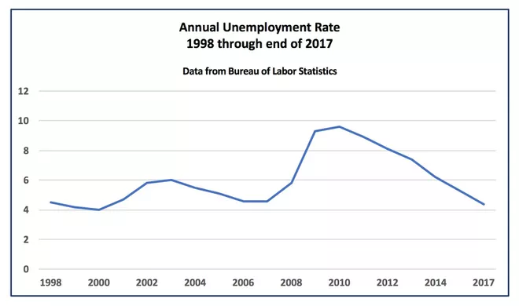
Credits : U.S. Bureau of Labor Statistics

Slide 6
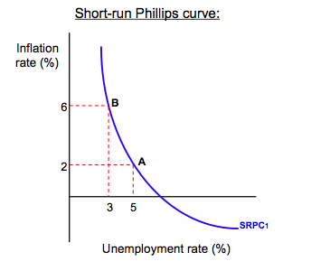
Philips Curve

Slide 7
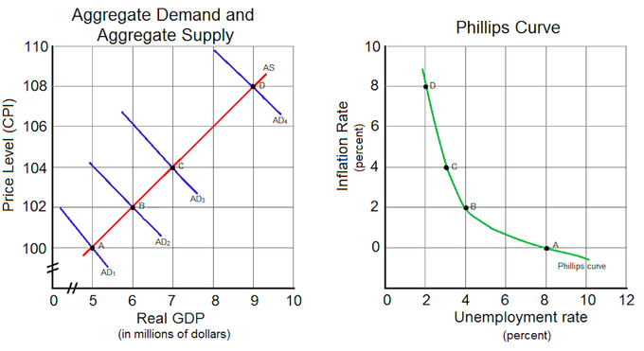
The Phillips Curve Related to Aggregate Demand

Slide 8
Motivation
To use the data from to analyze higher unemployment and inflation rates.
The goal is to test the existence of Phillips curve for the period 2000-2021 (Inflation v/s unemployment) and check if there is any difference in unemployment rate based on ethnicity.

Slide 9
Theory and Hypothesis
Hypothesis based on previous research
Does higher unemployment correspond to lower inflation rates?
H0: Inflation does not corresponds with unemployment.
H1: Inflation corresponds with unemployment.

Slide 10
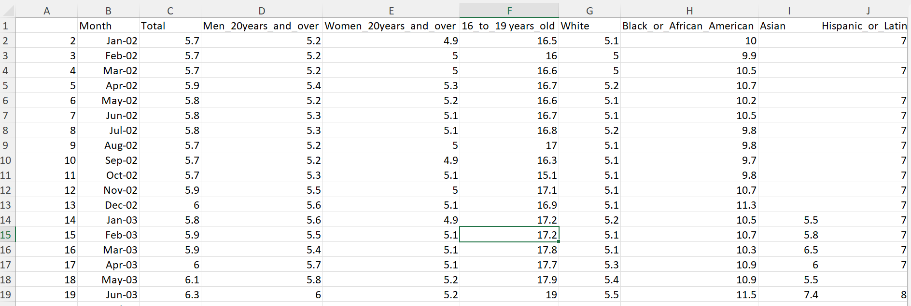
About Data
Important variables of our datasets are:

Slide 11
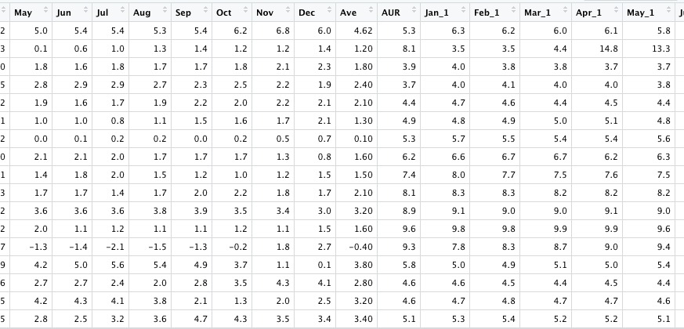
And...we also worked on the inflation dataset..

Slide 12
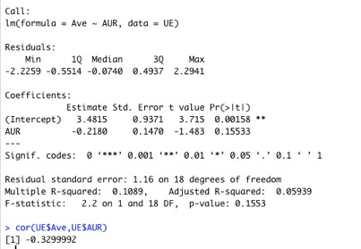

Slide 13
m1 <- lm(Total ~ White, data = UE)
summary(m1)
coeftest(m1, vcov. = vcovHC, type = "HC1")

Slide 14
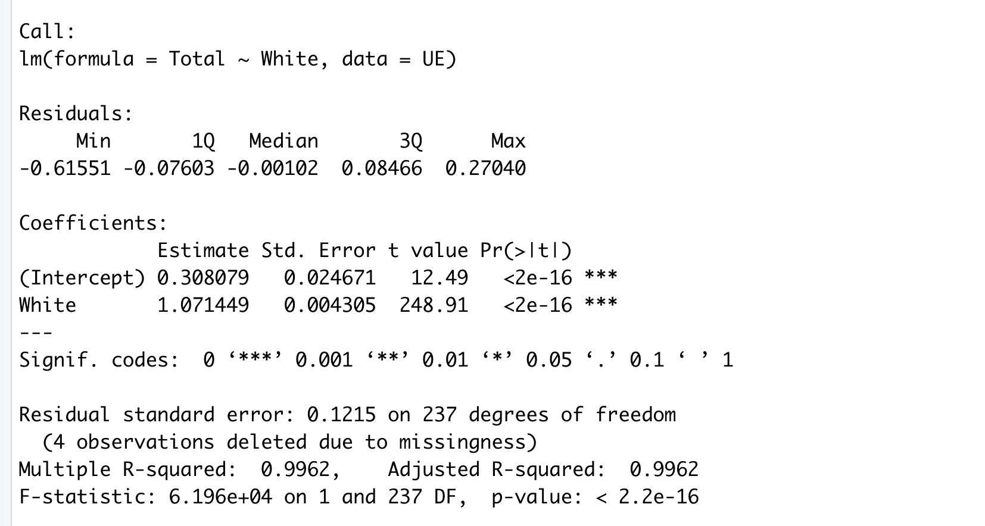

Slide 15
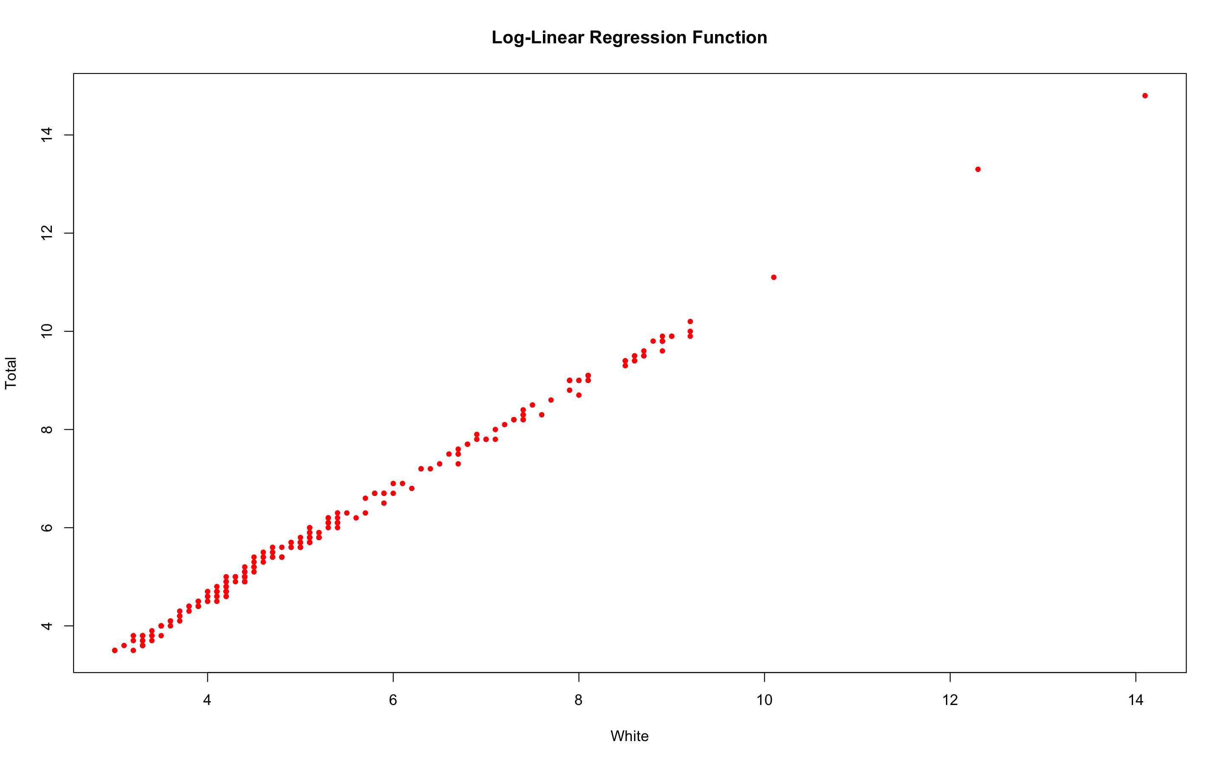

Slide 16
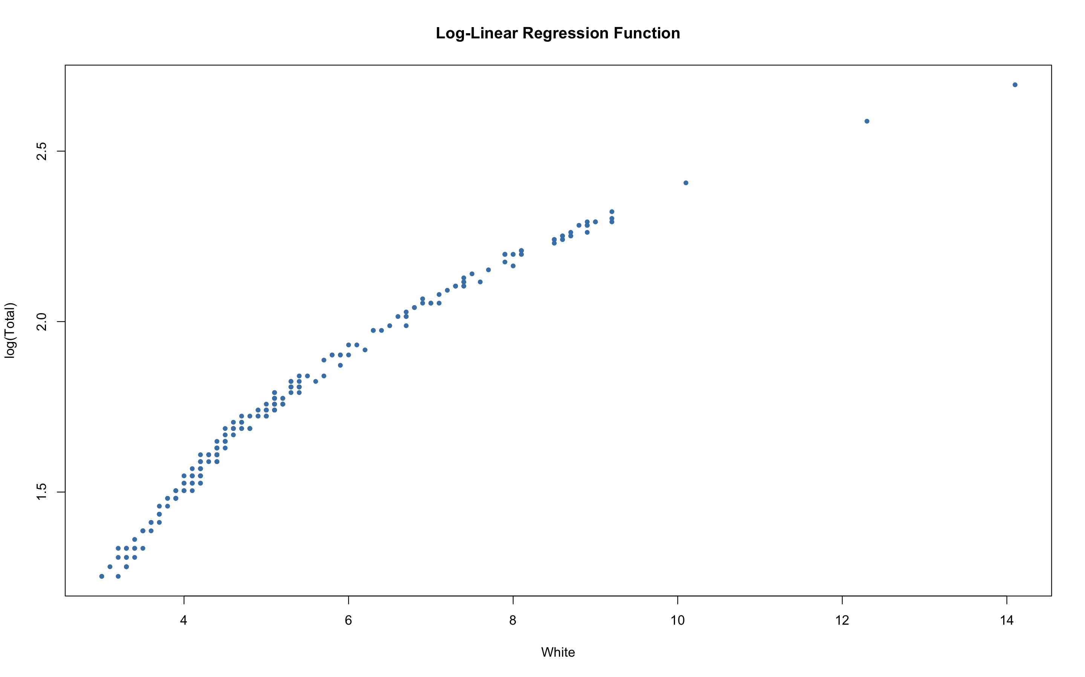

Slide 17
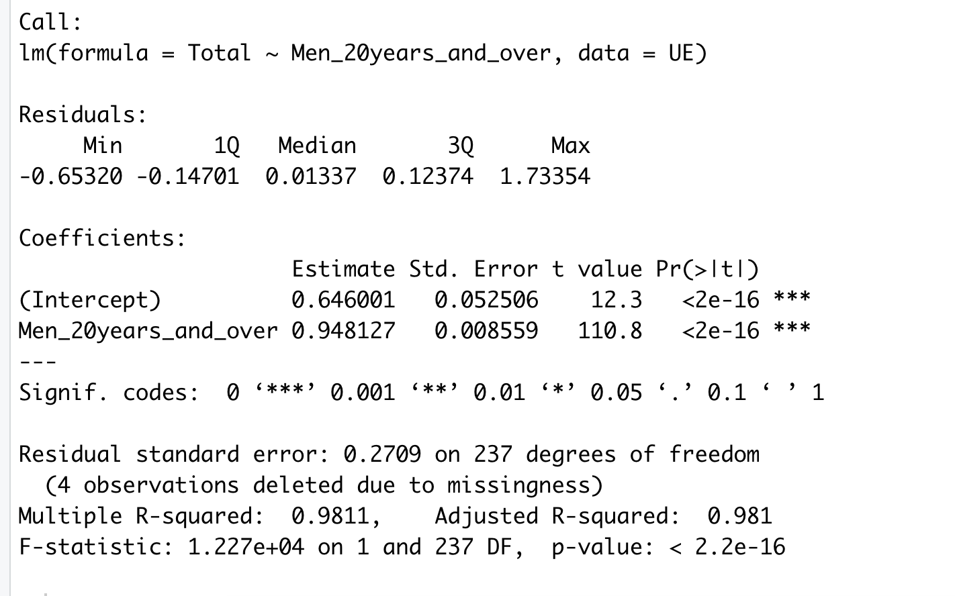

Slide 18
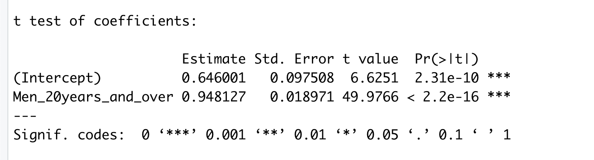

Slide 19
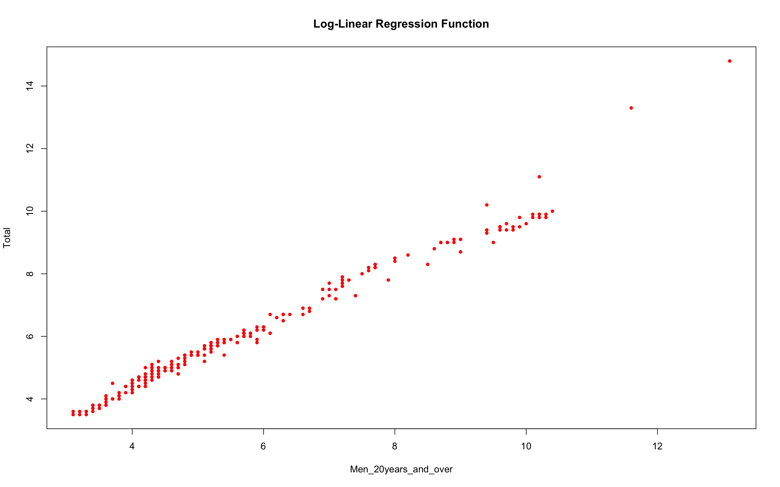

Slide 20
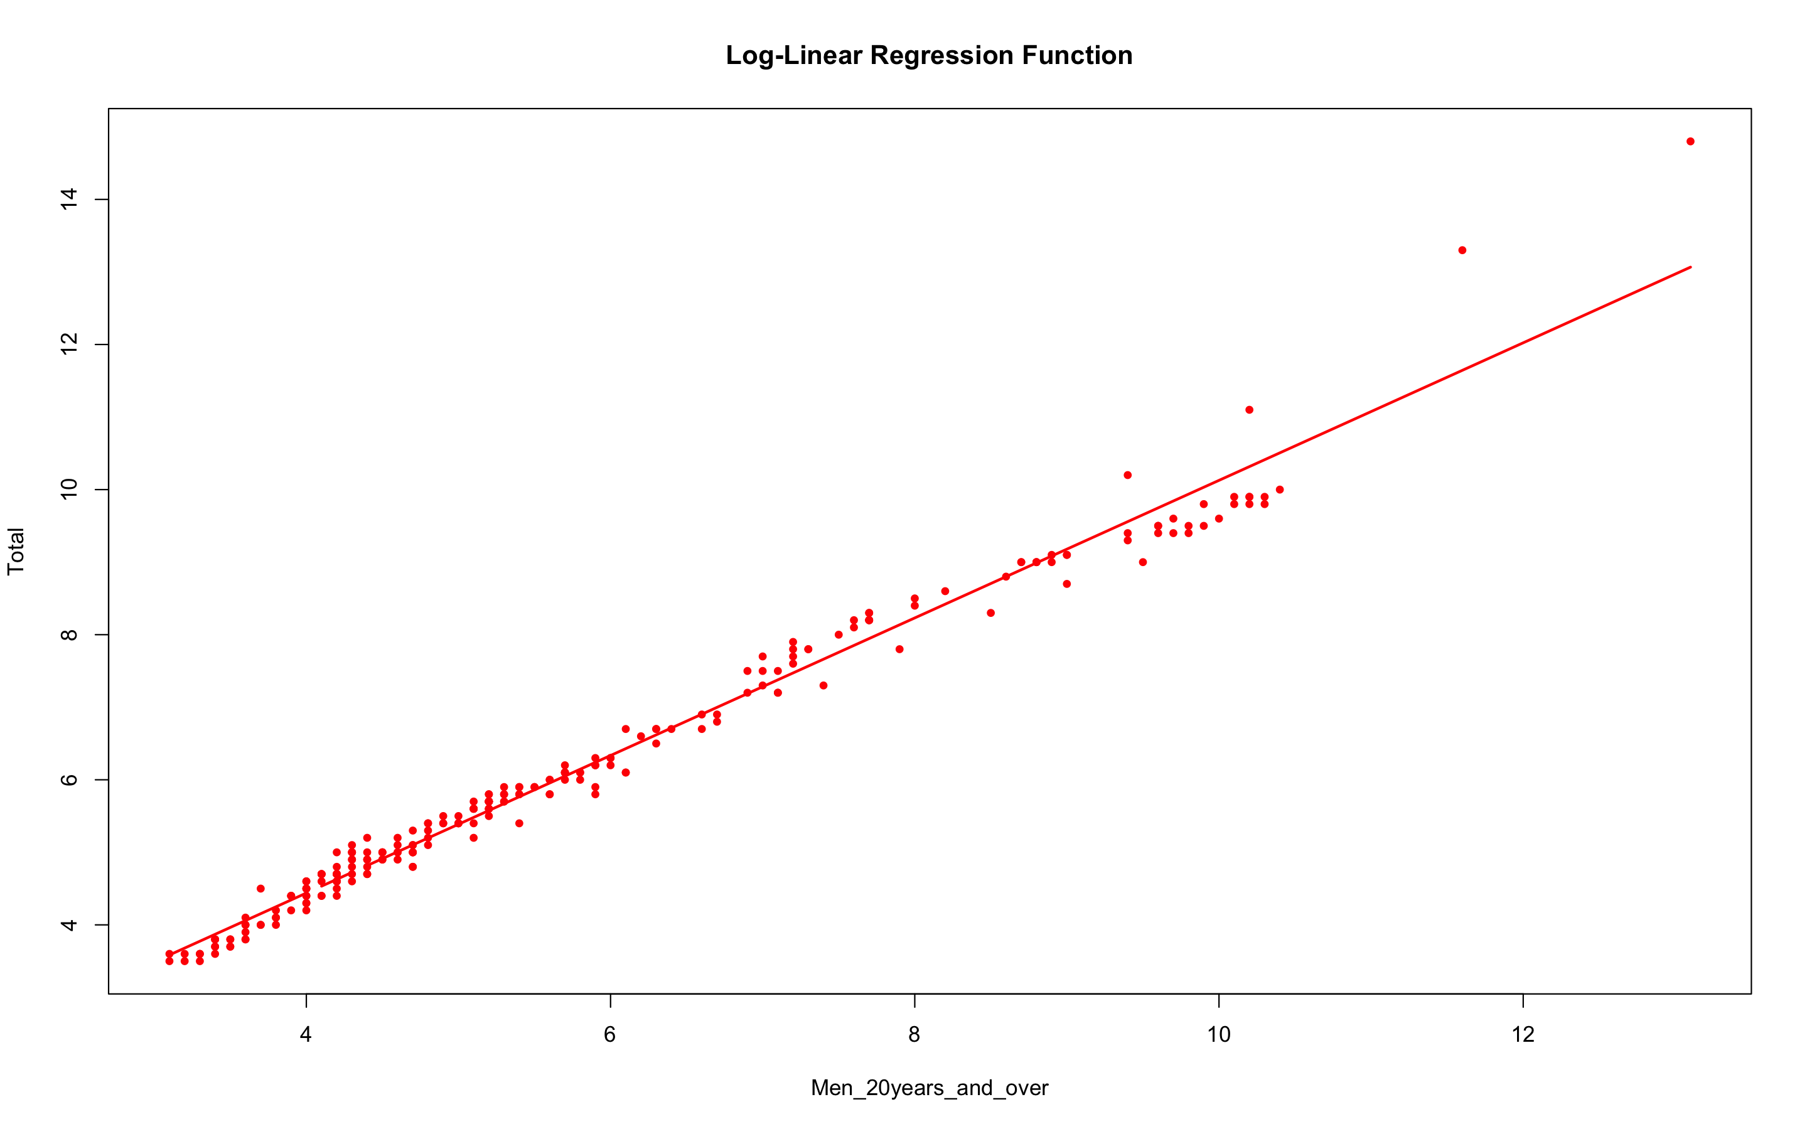

Slide 21
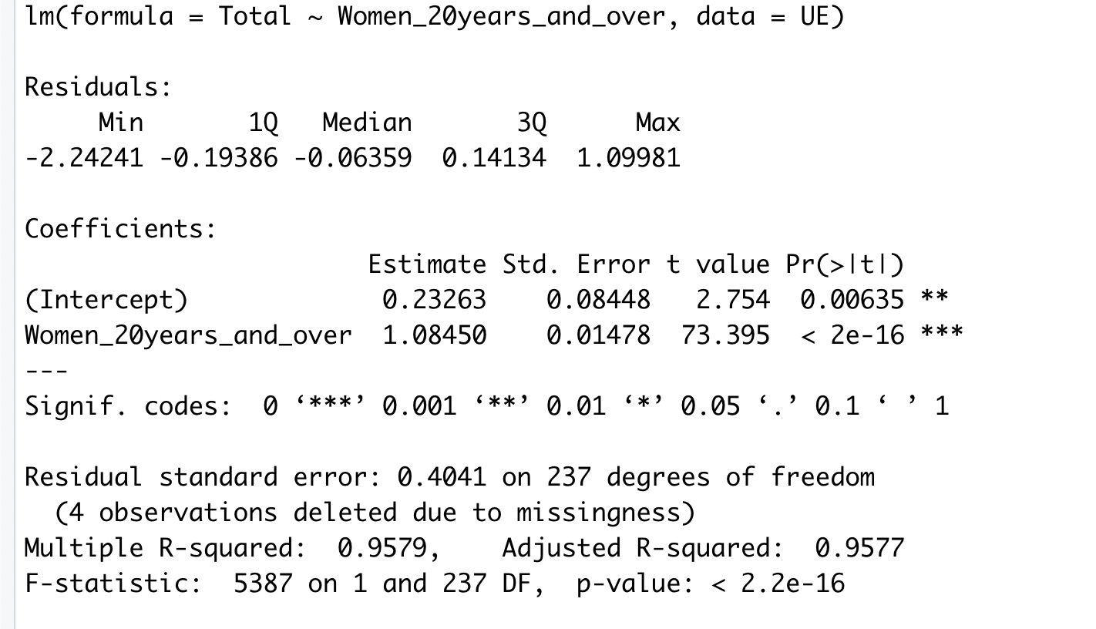

Slide 22
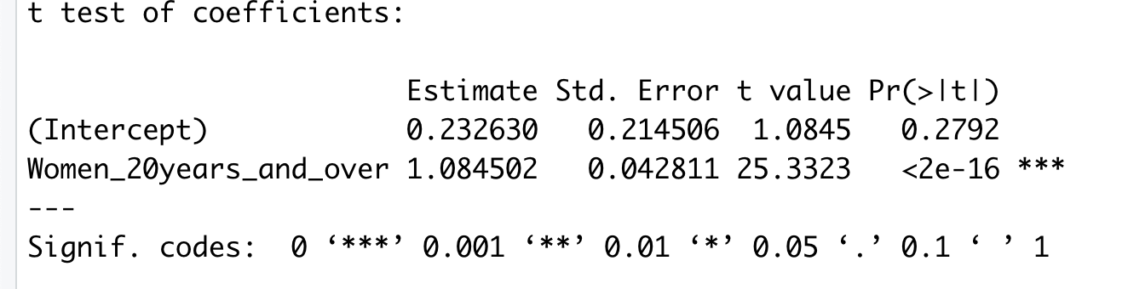
T-test for coefficients

Slide 23
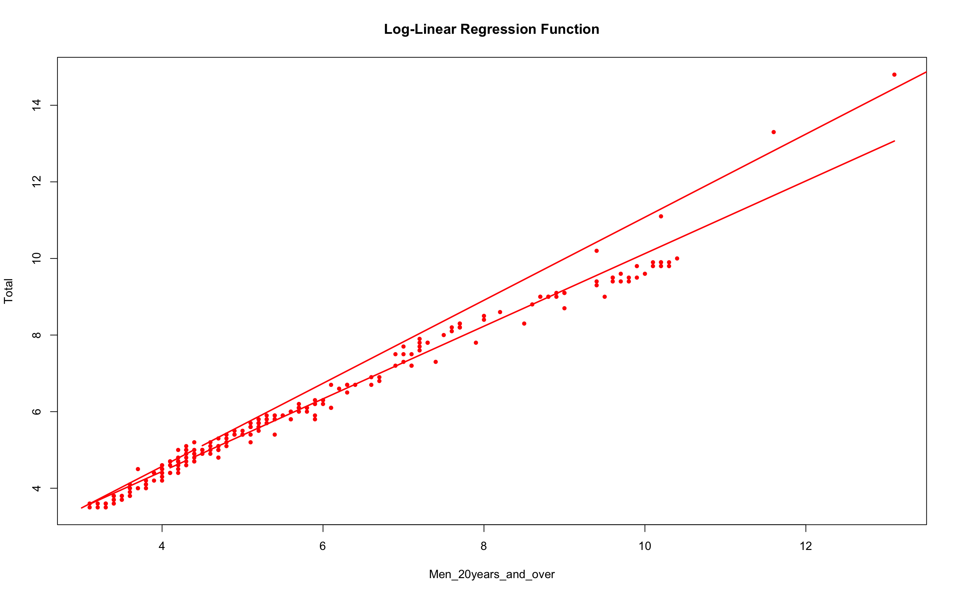

Slide 24
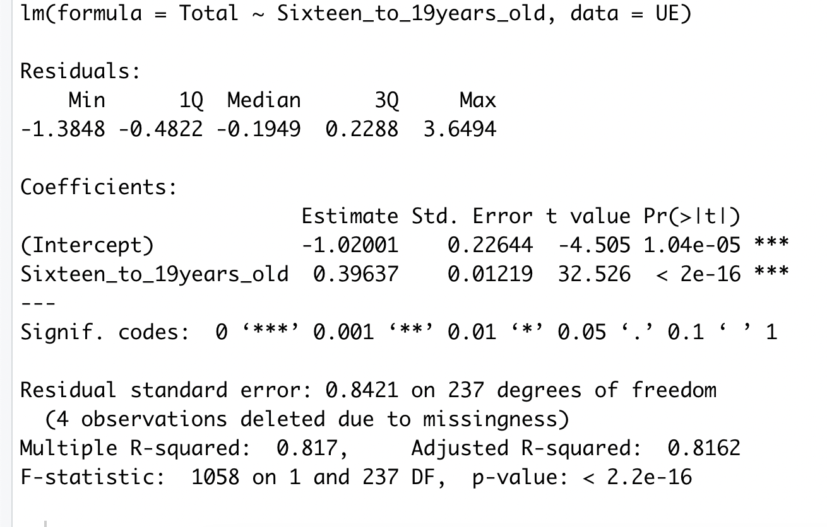
Regression model for 16 to 19 years old

Slide 25
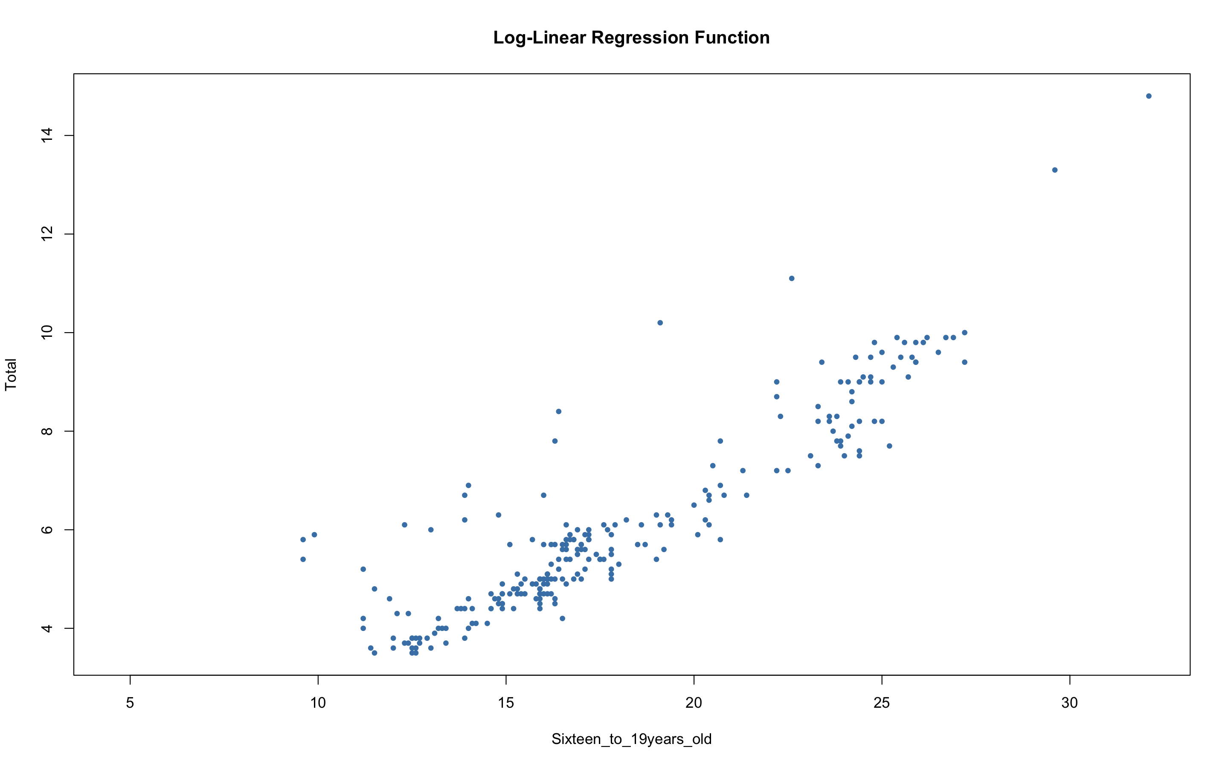

Slide 26
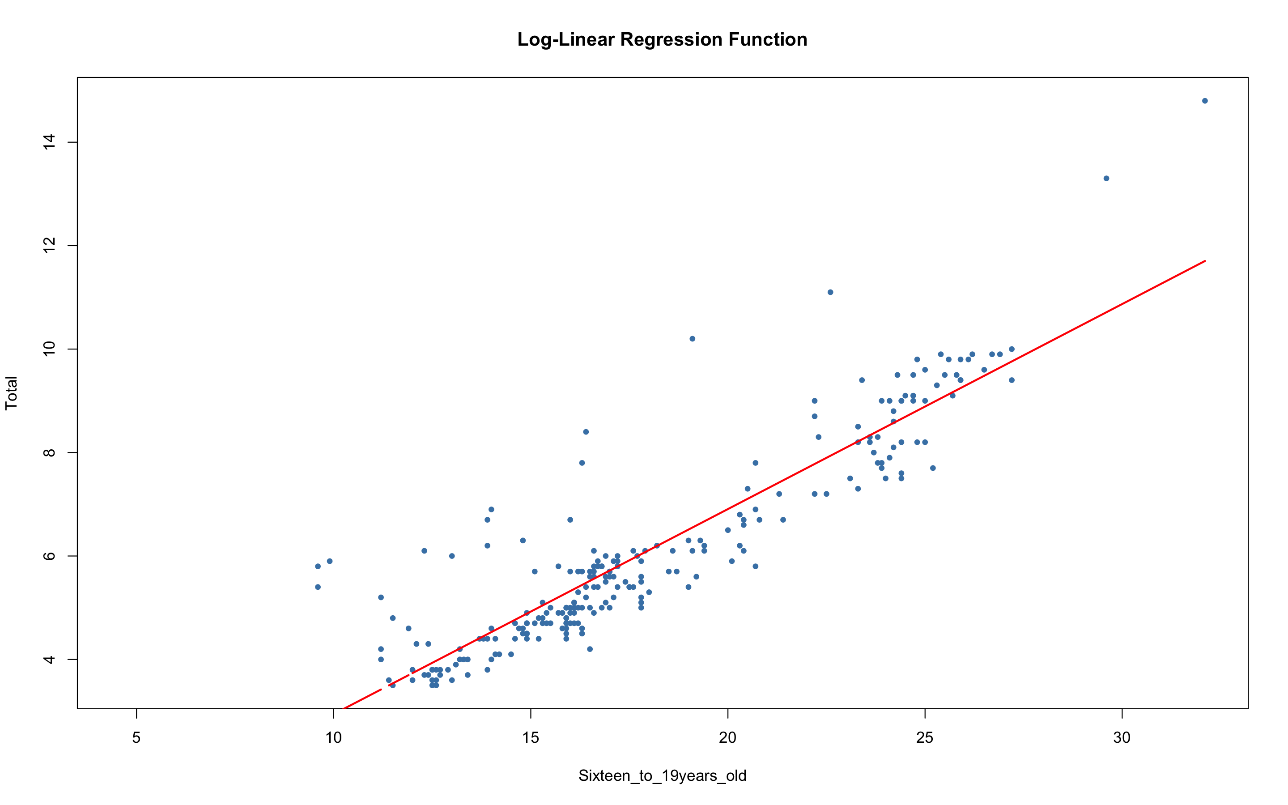

Slide 27
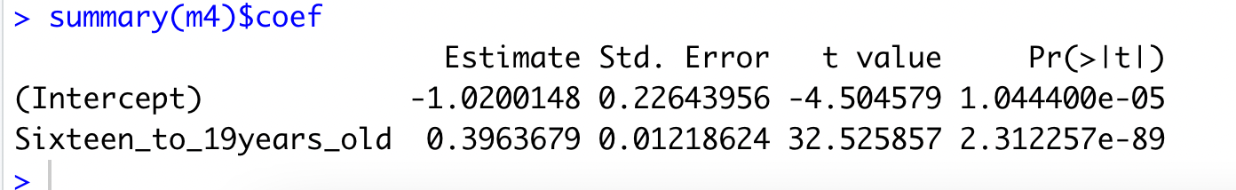
summary(m4)$coef

Slide 28
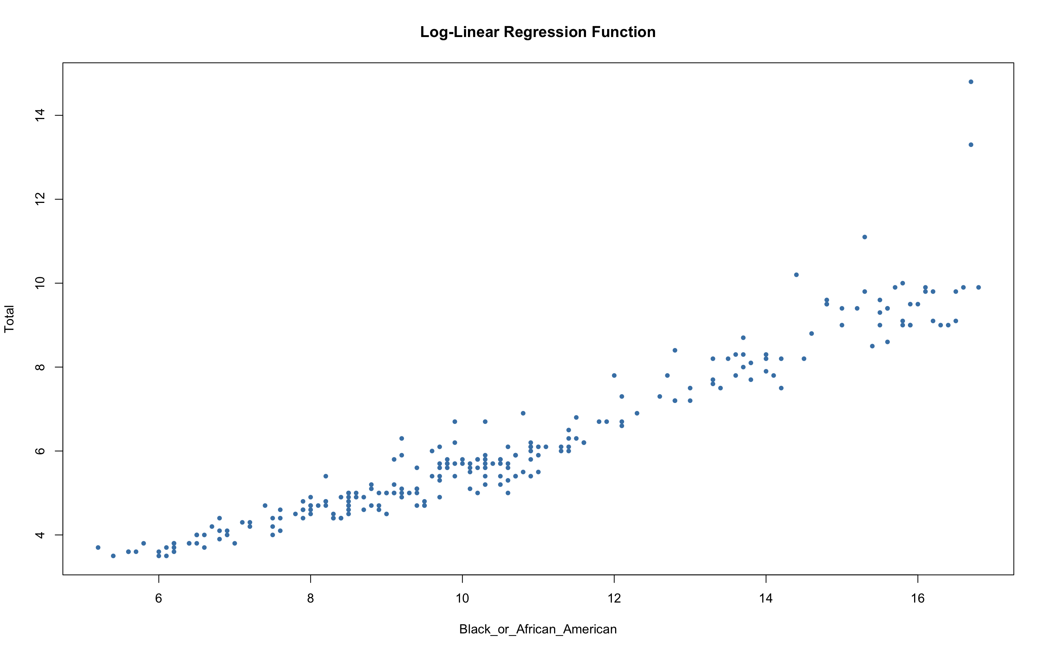

Slide 29
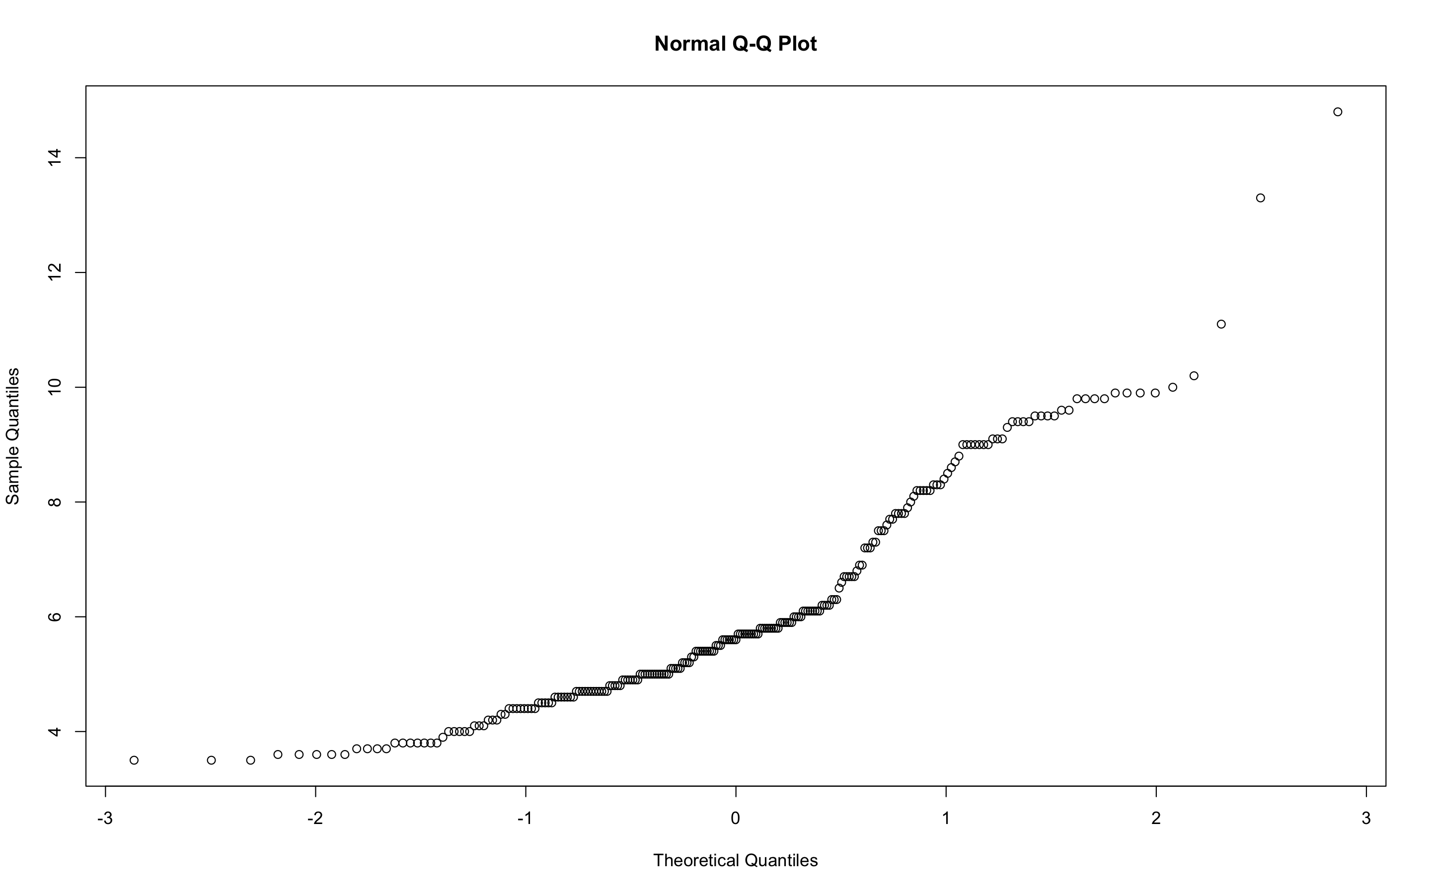

Slide 30
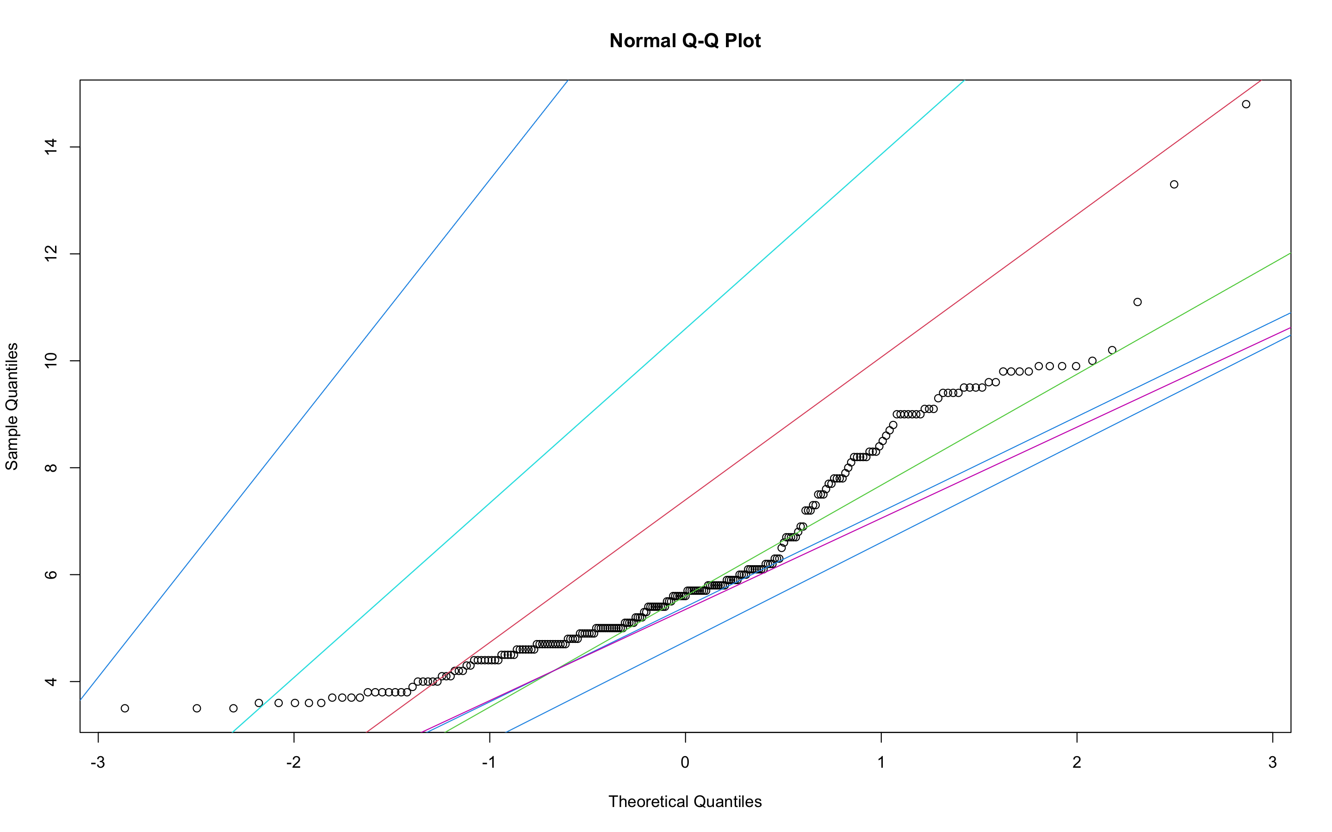
Normal Q-Q plot

Slide 31
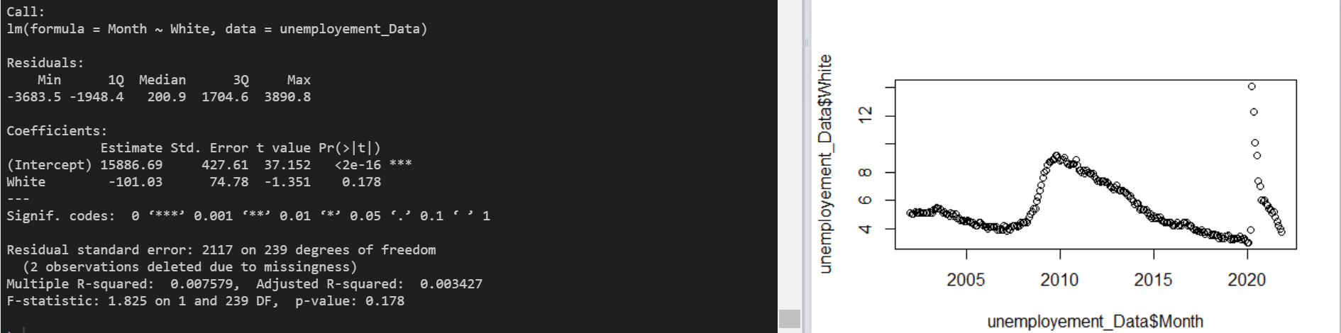
Linear models for Unemployement rate where ethnicity = White

Slide 32
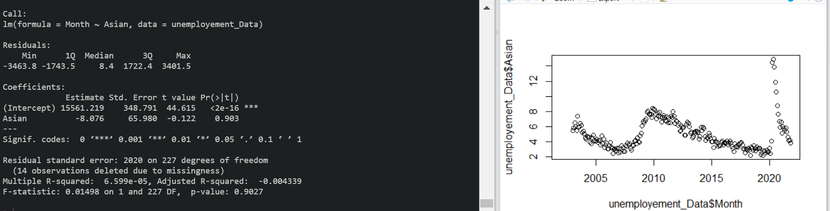
Linear models for Unemployement rate where ethnicity = Asian

Slide 33
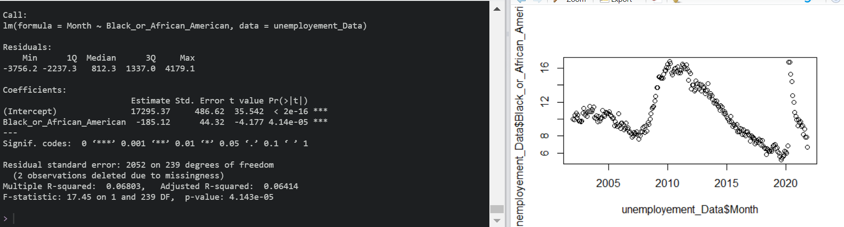
Linear models for Unemployement rate where ethnicity = Black_or_African_American

Slide 34
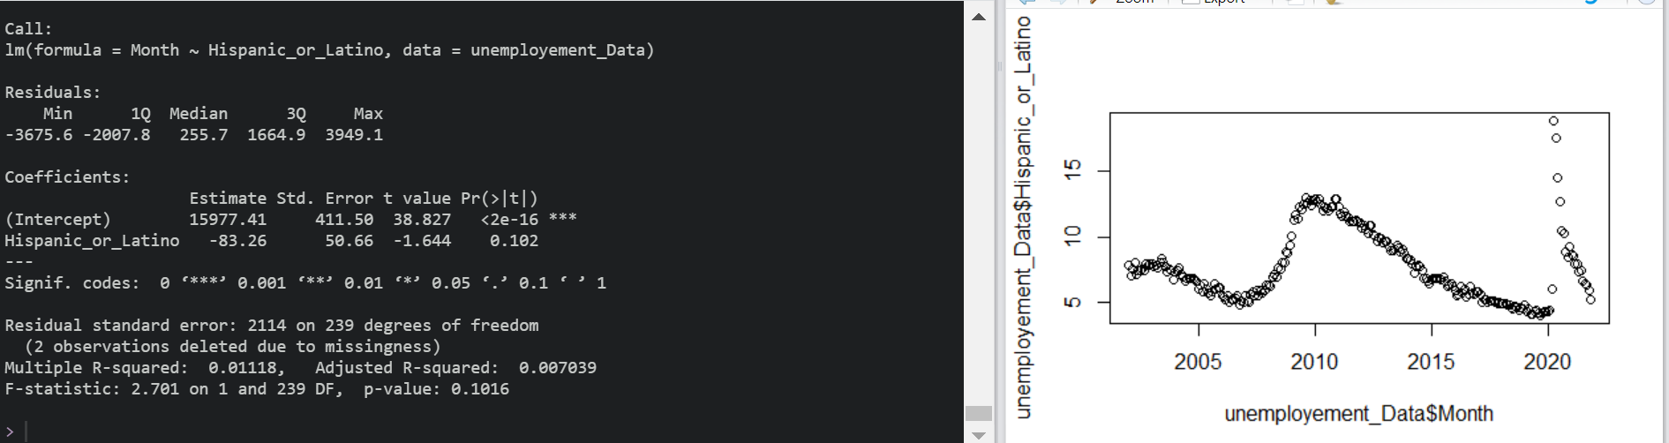
Linear models for Unemployement rate where ethnicity = Hispanic_or_Latino

Slide 35
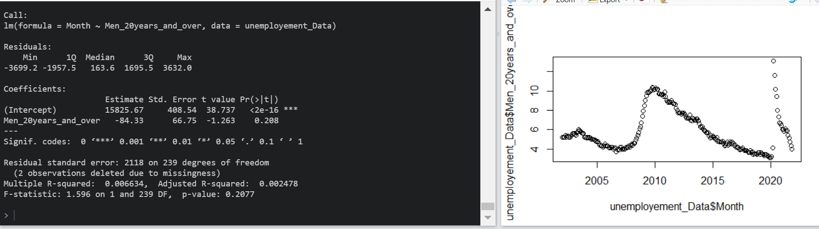
Linear models for Unemployement rate for Men_20years_and_over

Slide 36
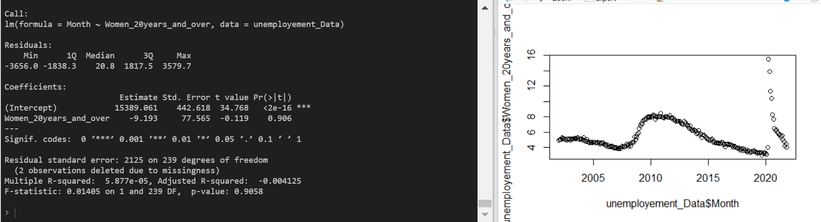
Linear models for Unemployement rate for Women_20years_and_over

Slide 37
Conclusion
The future research direction would be that we’ll test the model by introducing attributes like location, education and background checks.
It might not be easy to predict how much inflation increases with the increase in unemployment.
According to our study, we conclude that there are relationships between Inflation and Unemployment. It Charges and various factors which are education, number of jobs, money people have. However, there might be a lot more major factors.

Slide 38
Thank you! Any Questions ?

